Slide 1
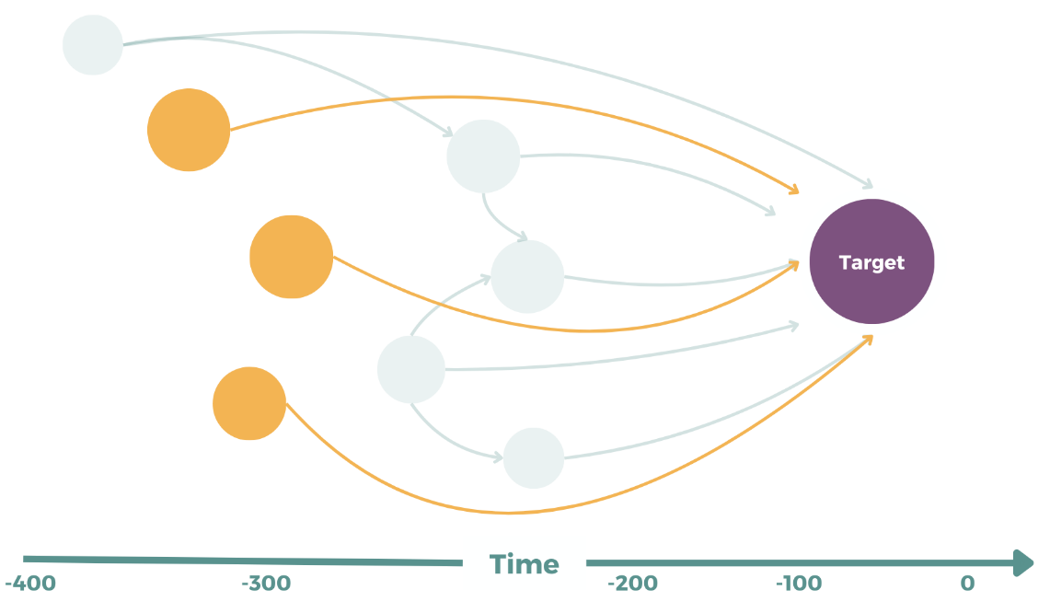
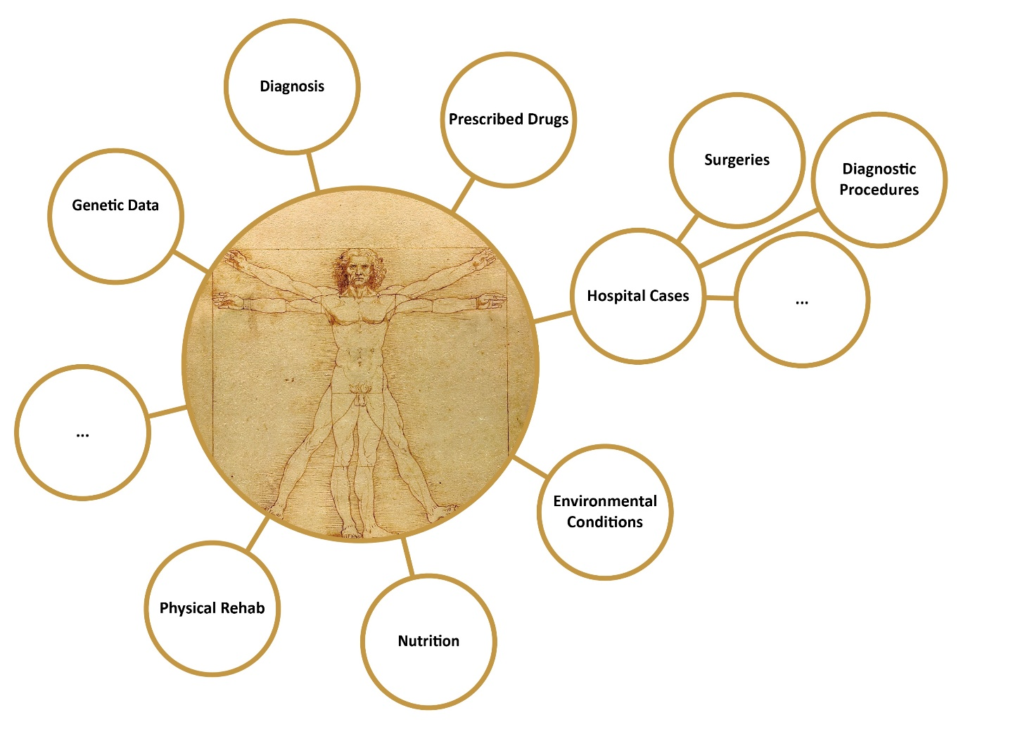
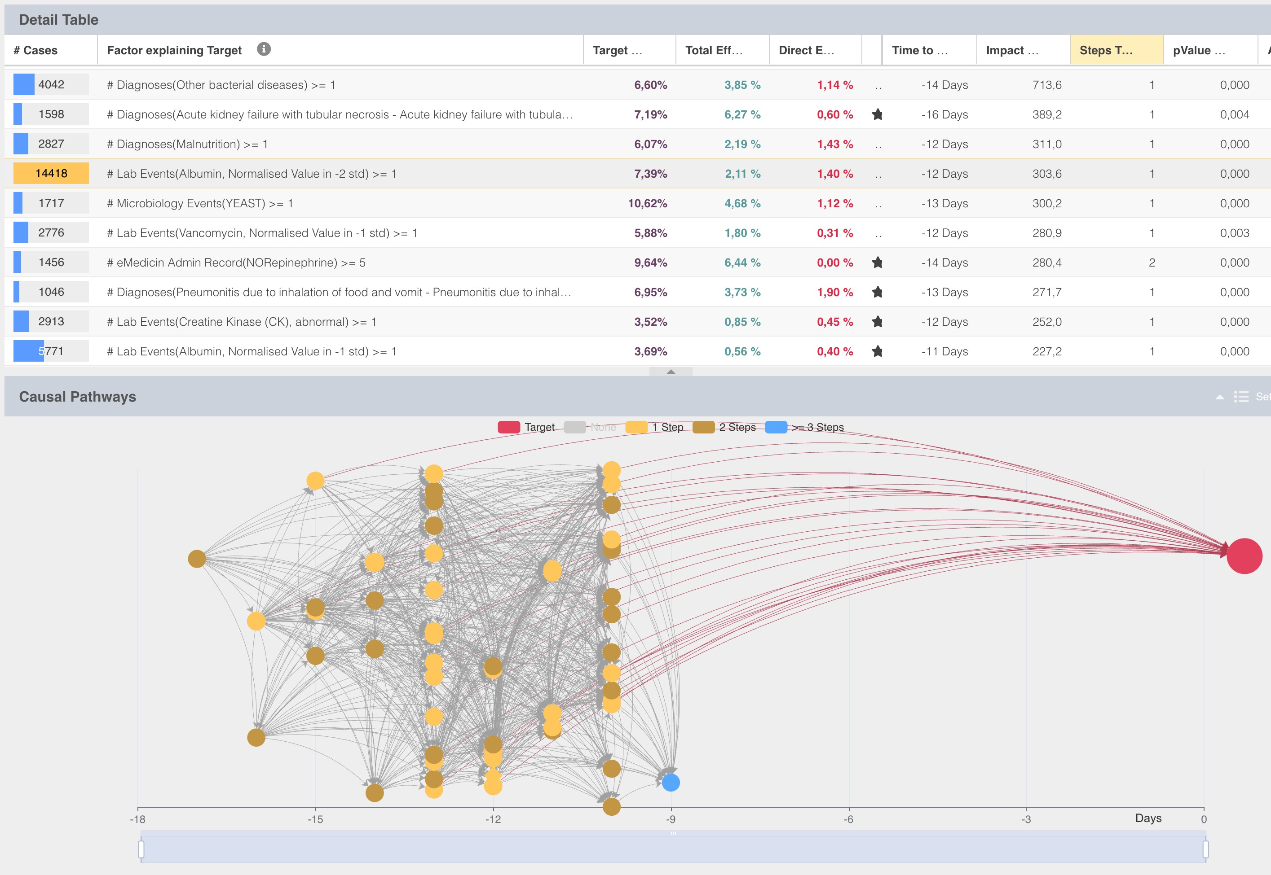
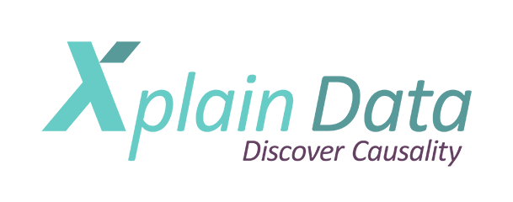


Object-Centric Causal Discovery in MIMIC-IV
A discovery-to-inference workflow for identifying candidate upstream drivers of hospital-acquired pressure injury
Classic Causal Discovery on a flat table returns an equivalence class, not an oriented DAG
MSR72
PRESENTER:
Andy Wilson
wilson.stats@gmail.com
Results from a real-world data example:
Hospital-acquired pressure injuries in the ICU: Using MIMIC IV v 3.1:
Abstract
Background / Objective
Traditional causal discovery algorithms face critical limitations in healthcare: they assume “flat” datasets, struggle with EHR relational complexity, and yield equivalence classes rather than fully-oriented graphs. We present an object-centric approach that encodes clinical constraints (temporal precedence, relational structure, informative missingness) while enabling data-driven discovery within that structure. We applied this method to identify candidate causal factors for hospital-acquired pressure injuries (HAPrI) in MIMIC-IV (v3.1).
Methods
Using MIMIC-IV adult ICU admissions, we represented patient journeys as temporally ordered “objects” (admissions, procedures, medications, labs) and applied a causal discovery algorithm operating directly on this relational structure without flattening. Domain knowledge constrained the search space, enforcing temporal precedence to minimize target leakage and encoding missingness mechanisms, while the algorithm screened millions of candidate dependencies to construct a sparse causal graph.
Results
The algorithm prioritized hypoalbuminemia as a candidate upstream driver of HAPrI, pending clinician review and confirmatory target-trial / TMLE analysis. It rediscovered established risk factors (mechanical ventilation, hemodynamic instability, immobility, moisture exposure, yeast colonization) without manual feature engineering, and flagged fluid management patterns and albumin administration timing as secondary candidate edges.
Conclusions
Object-centric causal discovery offers a middle path between purely data-driven search and expert-specified DAGs: clinical knowledge disciplines the algorithm, while the algorithm surfaces relationships experts might overlook. Future work will engage clinicians to refine the graph and employ modern causal estimators (TMLE, longitudinal g-methods) to quantify effects of albumin and other interventions on HAPrI risk.
The causal-discovery search operates directly on this relational/object structure
... thereby taking temporal precedence into account
Michael Haft, PhD¹,
Jenny Alderden,PhD, RN, FAAN²,
Andy Wilson, PhD, MStat^{3,4*}
¹Xplain Data, Munich, ²Boise State University,
³ University of Utah, ⁴Tao of RWD, *Presenter
Notes:
Notes:
In Powerpoint, click View > Guides
Keep text within gutter guides.
Author list: Don’t split names onto two lines (e.g., “Jimmy [break] Smith”). If that happens, use a new line, unless you need the space. Bold the first names of anybody who’s presenting in person.
Intro/methods/result: Do not drop below font size 28, but if you have extra space, jack up the font size until the space is full.
Do not use color in the sidebars except in graphs/figures. It’ll pull attention from the center and slow interpretation for passersby.

